Slide 1
Elastic Stack for Tango logs
How to collect logs with Elastic Stack and what can we achieve with it ?
Notes:
Hello everyone, I’m Anatole, an apprentice at SOLEIL working on Elastic Stack.
I am going to talk about the Elastic Stack and its application in managing Tango Logs.
We'll look at how to collect logs with the Elastic Stack and what we can achieve with it. During this presentation, we'll cover five key points:
first, I'll give you a quick overview of the Elastic Stack;
then, we'll look at our architecture and infrastructure at SOLEIL;
next, I'll show you the collect, the transformation, and the parsing of Tango logs
and finally, we'll explore data visualization using Kibana.
Please note that everything you will see in this presentation is currently at the proof-of-concept stage. It is an advanced proof of concept, but it is not yet widely used at SOLEIL.

Slide 2
Elastic Stack Overview
Notes:
So first, a quick overview of Elastic Stack

Slide 3

Elastic Stack Overview
What is Elastic Stack ?
Elastic Stack: Tools for managing and analyzing data.
Handles logs, system monitoring, and beyond.
Scalable, robust, widely used.
Open-source
Elastic was founded in 2012.
Notes:
So, what is Elastic Stack?
Elastic Stack is a list of tools for managing and analyzing data.
It handles logs, system monitoring, and beyond.
It's scalable, robust, and widely used.
And note that the code for the Elastic Stack is open-source.
To put things in context, Elastic, the company behind Elastic Stack, was founded in 2012. (two thousand and twelve)

Slide 4
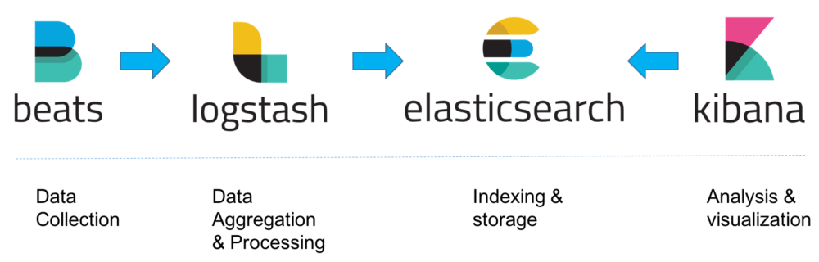
Elastic Stack Overview
Collet logs
Parse & structure log
Search engine
Visualize log
Notes:
So, here is the list of Elastic Stack tools. In order, we have:
Elasticsearch, the heart of the Elastic Stack, is a search engine that indexes and stores data. It’s a NoSQL database And finally, we have Kibana to visualize data.

Slide 5
Architecture & Infrastructure

Slide 6

Architecture & Infrastructure
Cluster Architecture
Front End Nodes: 2
Services: Kibana & Logstash
Elasticsearch Master Nodes: 3
Primary Role: Indexing Data
Elasticsearch Data Nodes: 4
Primary Role: Storing Indexed Data
10 TB Available
Deployment Technologies
Notes:
Elasticsearch is a distributed application that runs as a cluster.
In this cluster, we have different nodes for different purposes.
10TB of Disk and 64 GB of memory
Installation through ansible and docker :
Ansible is an automation tool.
Docker is a containerization tool.

Slide 7
Collecting Logs
Filebeat

Slide 8
Collecting Logs
What is Filebeat?
Ingests logs
Lightweight: Developed in Go
Robust: Remembers where it stopped.

Slide 9
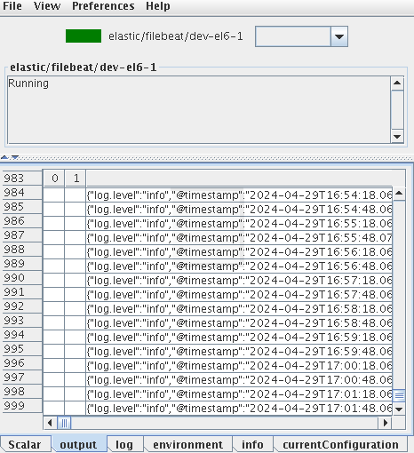
Collecting Logs
Tango device to manage Filebeat
Only a Filebeat frontend:
Start and stop Filebeat
View Filebeat logs
View Filebeat configuration
Configure Filebeat through properties
Notes:
- …
- To have a good overview through atk panel

Slide 10
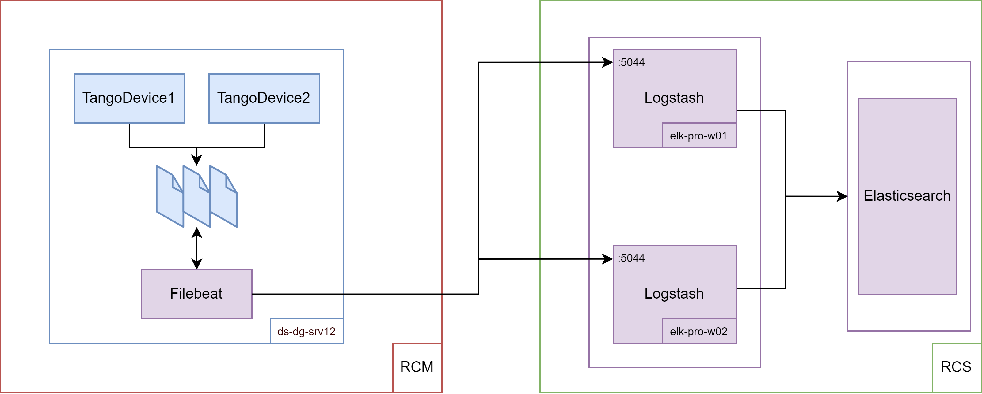
Collecting Logs

Slide 11
Logstash

Slide 12
Logstash
What is Logstash ?
Parsing field of logs with filter
Sort log by format and log level with pipeline

Slide 13
Logstash
<log4j:event logger="flyscan/core/recording-manager.1" timestamp="1685627" level="INFO" thread="4130">
<log4j:message><![CDATA[Initialization done.]]></log4j:message>
<log4j:NDC><![CDATA[]]></log4j:NDC> </log4j:event>
Filter for Tango logs
Fields :
Timestamp
Thread
Level
Message
Device Name
filter {
mutate {
gsub => ["message", "log4j:", ""]
}
xml {
source => "message"
target => "xml"
force_array => false
}
date {
match => [ "[xml][timestamp]", "UNIX_MS" ]
remove_field => [ "[xml][timestamp]" ]
timezone => "Europe/Paris"
}
mutate {
rename => {
"[xml][logger]" => "[Device][Name]"
"[xml][thread]" => "[process][thread][id]"
"[xml][level]" => "[log][level]"
"[xml][message]" => "[message]"
}
remove_field => "[xml]"
}
}

Slide 14
Kibana
Data visualization

Slide 15
Kibana
What is Kibana?
Web-based Visualization Tool
Create Dashboards
Data Exploration
Configure part of elastic search
Manage our cluster
Notes:
… - Configure part of elastic search : for exemple if you want to add a field quickly (runtime field) to your data, you can do it with Kibana and it’s very convenient
The next slide contains screenshots of Kibana visualizations. However, because Kibana is highly responsive, refreshes rapidly, and it’s great, I prefer to show you live Kibana dashboard.

Slide 16
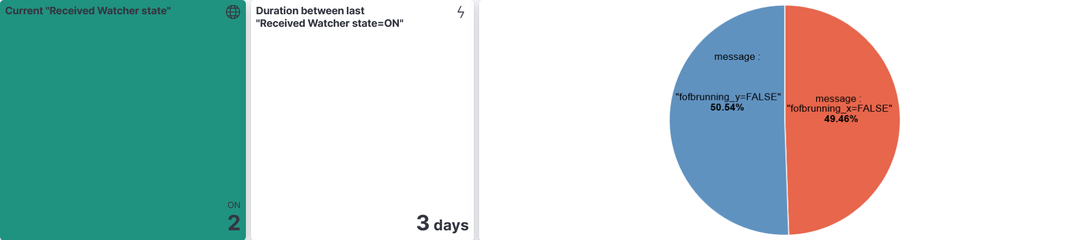
Kibana
Explore & Visualize
Notes:
The next slide contains screenshots of Kibana visualizations. However, because Kibana is highly responsive, and refreshes rapidly, I prefer to show you live Kibana dashboard.

Slide 17
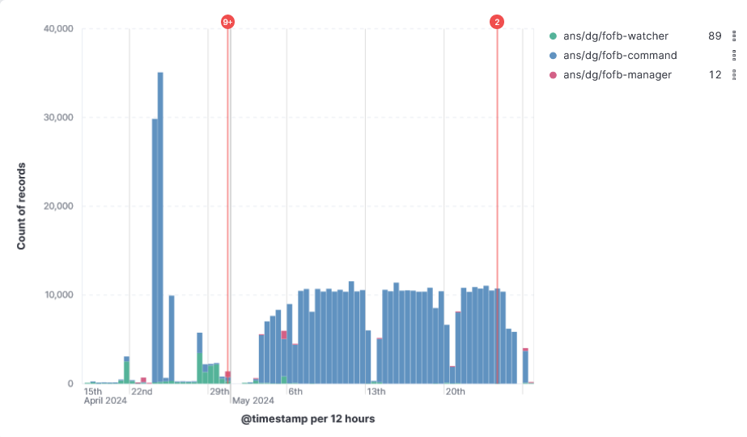
Kibana

Slide 18
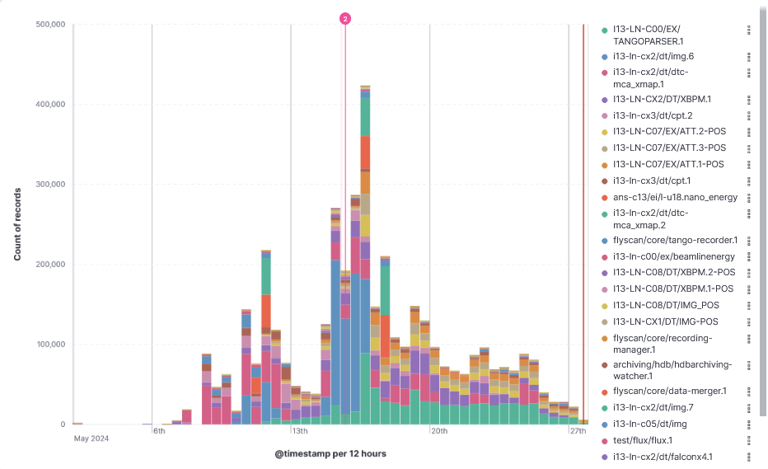
Kibana

Slide 19
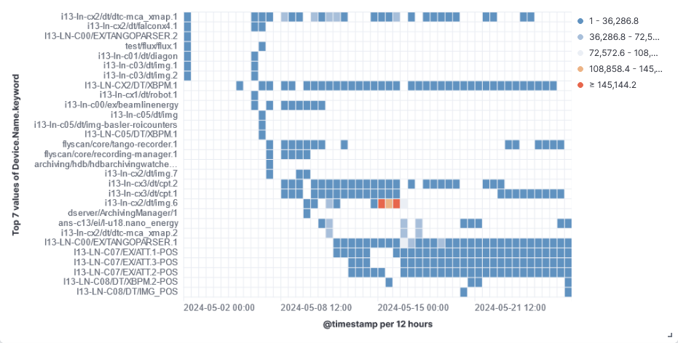
Kibana

Slide 20
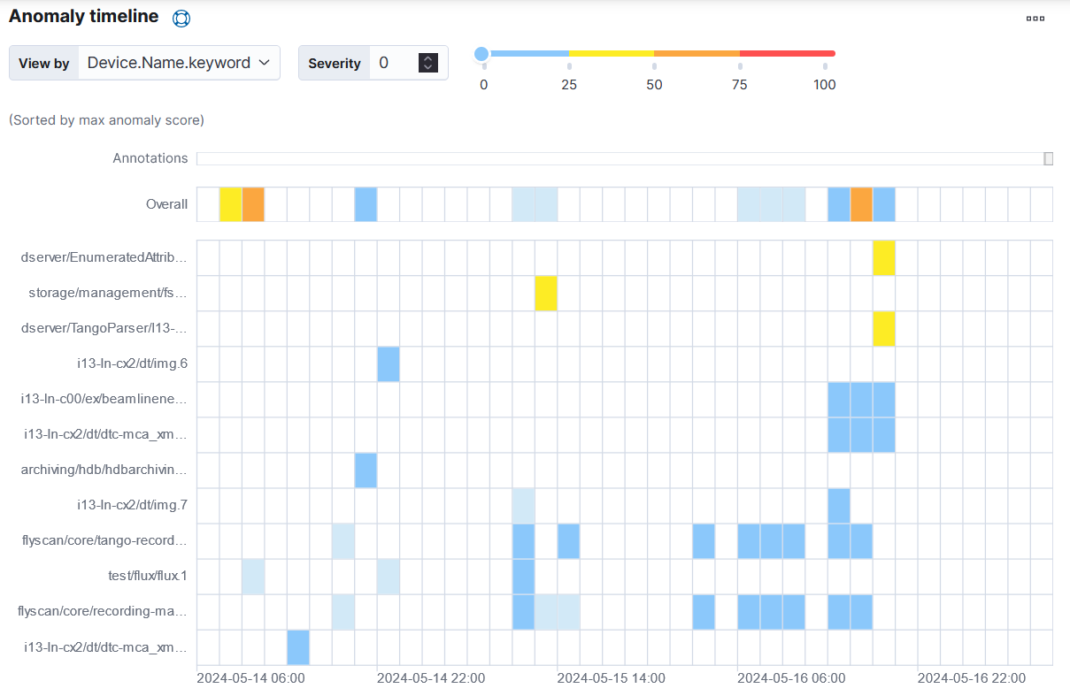
Kibana
Anomaly Detection
Notes:
Rare
Detect rare values in time series data.
The algorithms are a mixture of techniques, including:
Clustering
Various types of time series decomposition
Bayesian distribution modeling
Correlation analysis
If a device produce lot of logs but consistently, Anomaly Detection of Elasticseach don’t notice that as anomaly but, but If a device produce smal amount of log event an unique time, il will be highlighted by the Anomaly detection
Lenteur ruche ? The data file system was slow

Slide 21
Conclusion

Slide 22
Conclusion
Reviewed key components of the Elastic Stack.
Highlighted data visualization capabilities with Kibana.

Slide 23
Next Steps
Connect Filebeat to all beam lines to enable statistics and graphics across the entire synchrotron.
Establish a direct link between Kafka to aggregate additional data sources.
Utilize existing Elastic dashboards to monitor applications that support Elastic natively, such as API Manager.

